Slide 2


Slide 3
File Handling

Slide 4
Difference between Streams and Files
Programmer (user)
Stream (Interface)
Device (File)
FILE: Device ON which an action is to be performed; may be anything.
STREAM: Interface BETWEEN the user and the said device; independent of the device being accessed.

Slide 5
Associating a file with a stream:
FILE *pointerName;
- Declaration and initialization
- Value of pointerName
- Use and significance

Slide 6
fopen
fclose
fgets OR gets
fgetc OR getc
fputs OR puts
File Handling functions
fputc OR putc
feof
freopen
fread
fwrite

Slide 7
fopen()
FILE *pointerName;
pointerName = fopen(fileName, mode);

Slide 8
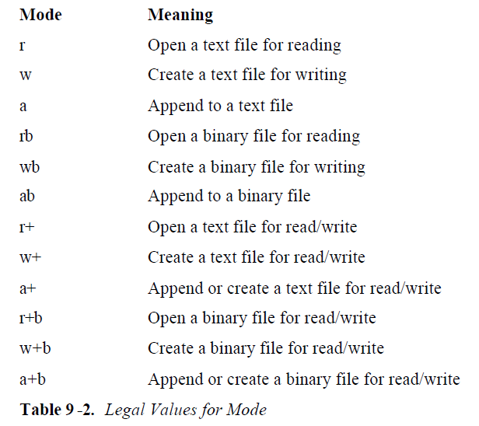
Input modes

Slide 10
fclose()
int fclose(FILE *pointerName)
- Purpose
- Failure

Slide 11
fputc() or putc() Mode: write mode (w, wb, w+, w+b)
int putc(char ch, FILE *pointerName);

Slide 12
fgetc() or getc() Mode: read mode (r, rb, r+, r+b)
int getc(FILE *pointerName);
- Purpose
- Failure and resolution

Slide 13
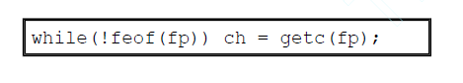
feof()
int feof (FILE *pointerName);

Slide 14
fputs()
Mode: write mode (w, wb, w+, w+b)
int fputs(const char *str, FILE *pointerName);

Slide 15
fgets()
Mode: read mode (r, rb, r+, r+b)
char *fgets(char *str, int length, FILE *pointerName);

Slide 16
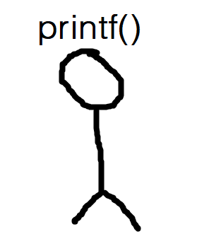

Remember these guys?
We can use also the data redirected to files instead of console!

Slide 17
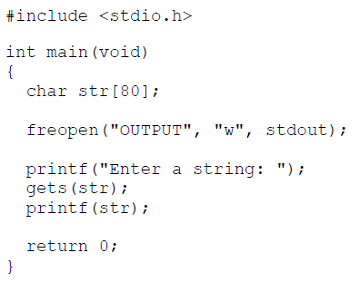
freopen() for redirection to:
stdin (standard input stream) stdout (standard output stream)
Example: freopen( ) to redirect stdout to a file called OUTPUT:
Page 259, C The Complete Reference by Herbert-Schildt

Slide 18
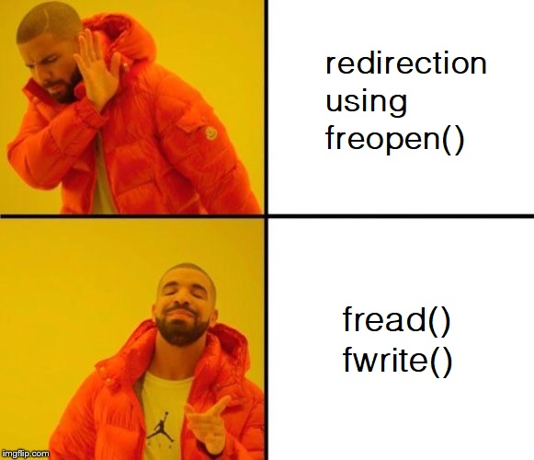

Slide 19
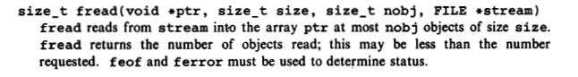
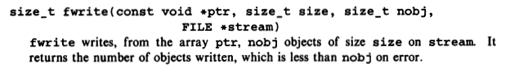
fread()
Page 247, Appendix B, The C Programming Language By K-R
fwrite()
Page 248, Appendix B, The C Programming Language By K-R

Slide 20
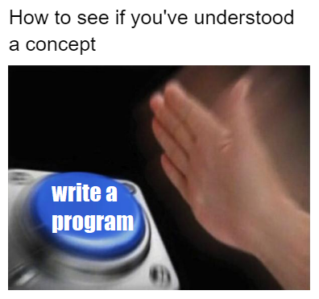

Slide 21
Let’s try a simple question (slides 21-23):
Make a simple text file, named MY_ASSIGNMENT.txt. (Hint: it is a new text file, and you will write to the file.)

Slide 22
Write characters in the file (can be anything), till a ‘$’ is entered. (Hint: use getch() to store the character)
Now, we want to copy the contents of MY_ASSIGNMENT.txt to another file called YOUR_ASSIGNMENT.txt.
As is obvious, you’ll have to create YOUR_ASSIGNMENT.txt now. (Hint: To copy, MY_ASSIGNMENT.txt shall be opened in input mode, and writing to YOUR_ASSIGNMENT.txt will require it to be opened in output mode)
(Ask us if you still have any doubts)

Slide 23
Open YOUR_ASSIGNMENT.txt and display its contents. Check if MY_ASSIGNMENT.txt has been correctly copied.

Slide 24
The answer for the question mentioned in slides 21-23 is given in the text file named SampleProgram, in the folder File Handling C.
(If your code differs slightly, as long as the basic aim of the aim of question is addressed you don’t need to worry.)

Slide 25
Contents of the folder File Handling C:
1. FileHandling_Reference: Introductory overview (includes: specifications of the discussion done with this presentation, links to external resources);
2. C The Programming Language by Kernighan-Ritchie;
3. C The Complete Reference by Herbert Schildt: For further general reader about the language;
4. SampleProgram (can be viewed in any text editor): Answer to the question given in this presentation.

